Slide 1
New Faculty Orientation
Welcome to Life at Lehigh
Webinar, June 27, 2025

Slide 2
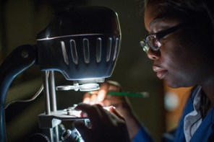


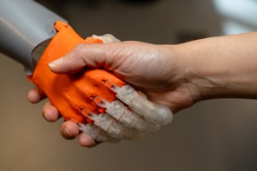
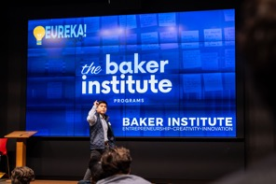
Five Colleges
College of Arts and Sciences
College of Education
College of Health
P.C. Rossin College of Engineering and Applied Science
College of Business

Slide 3
Five Colleges

Slide 4

Undergraduate Students
78
countries
5,624
undergraduates
49
states + DC and PR
18%
first-generation
31%
underrepresented

Slide 5

Academics
2300+
programs and courses
28
average class size
113
UG programs and majors
87
graduate programs
10:1
student-to-faculty ratio

Slide 6
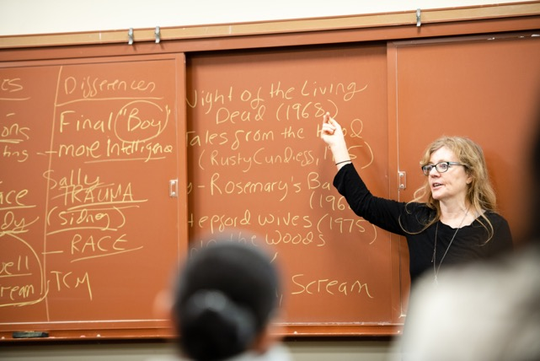
Faculty
411
tenured / tenure-track
508
full-time faculty
97
term faculty
$59M
sponsored research expenditures FY24

Slide 7


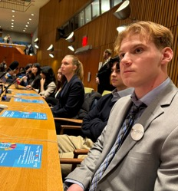


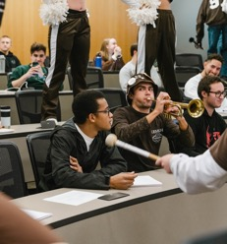



Slide 8
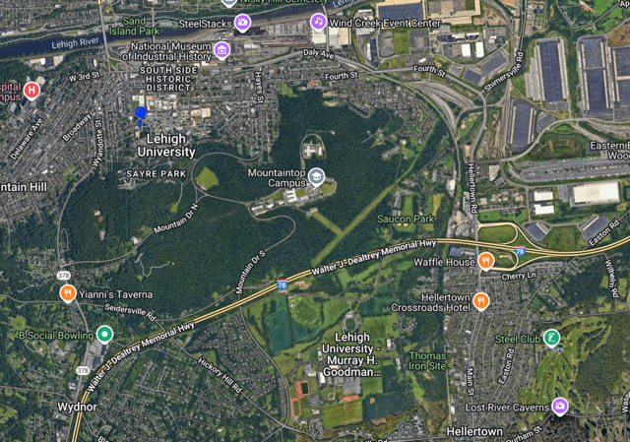
Three Campuses

Slide 9
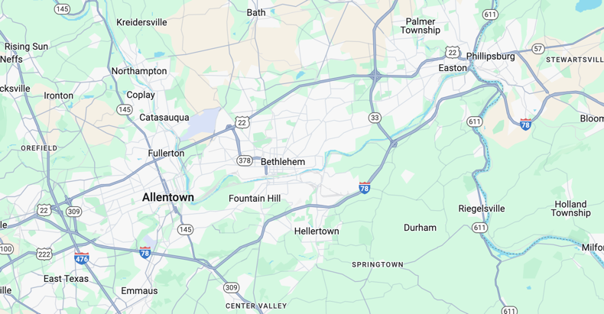
The Lehigh Valley

Slide 10
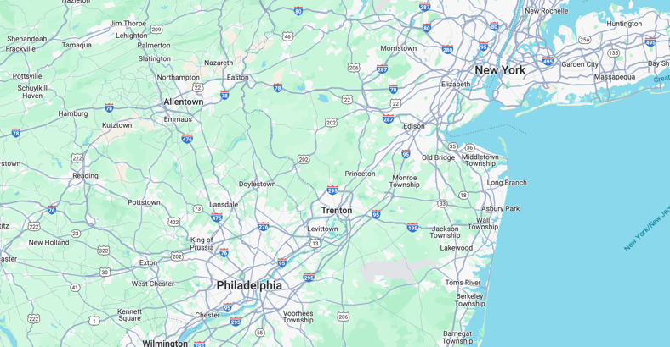
The Lehigh Valley

Slide 11


Slide 12


Slide 13
Lehigh “Org Chart”
Provost
Nathan Urban
Athletics
CAS
Bob Flowers
DPFA
Larry Snyder
Academic Sys. & Services
Communications
DPGE
Sabrina Jedlicka
Admissions & Financial Aid
COB
Manoj Malhotra
Development &
Alumni Rel’ns
Creative Inquiry
President
Joe Helble
DPUE
Terry-Ann Jones
Inclusive Excellence
COE
Robin Hojnoski*
International Affairs
Finance & Administration
Library & Tech. Services
COH
Beth Dolan
General Counsel
Research
Investment
RCEAS
Steve DeWeerth
Entrepreneurship
Strategic Planning
Student Affairs

Slide 14
College “Org Chart”
College
Dean
Dept. of …
Dept. Chair
Assoc. Dean
for Faculty
Assoc. Dean
for UG
Dept. of …
Dept. Chair
Assoc. Dean
for Research
Dept. of …
Dept. Chair
…
…

Slide 15



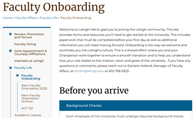
Resources for Learning Lehigh
Human Resources
Department Chair
Department colleagues
Associate Dean for Faculty
Faculty Affairs team:
Larry Snyder
Janele Krzywicki
Daniele Holland
Marci Levine
Alex Dunn
Faculty Onboarding website

